Slide 1

IPRO 497 - 204: Antimatter Gravity Interferometer
FINAL PRESENTATION
NOVEMBER 21, 2019

Slide 2
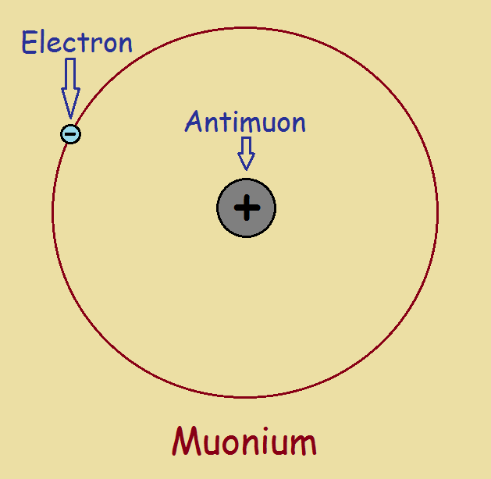
Introduction
Gravitational acceleration of antimatter - not directly measured
Goal: measure gravity of muonium through interferometer
Solve problems about dark energy & dark matter
Notes:
Text size is good, prof mancini said that the words in the picture are about as small as they should get.
Make sure to explain the picture here

Slide 3
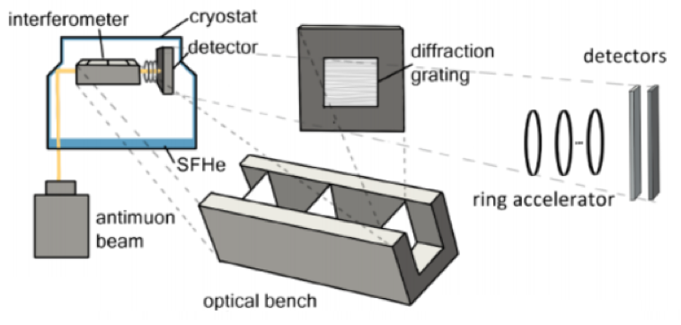
Process
Antimuon beam enters cryostat
Some antimuons converted to muonium in SFHe
Beam reflected into the interferometer
Beam diffracted by gratings
Pattern sampled by detector
Notes:
Muonium not muons** something wrong with #2

Slide 4
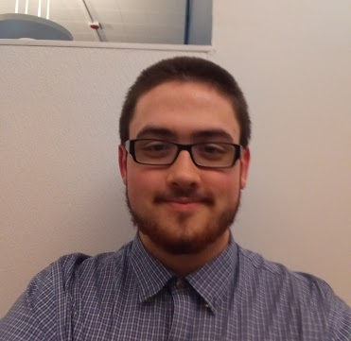
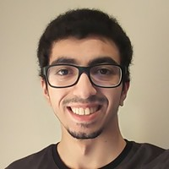
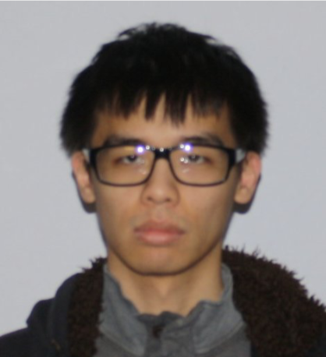
The Team
Optical Simulation Team
Henry Post - ITM ‘19 Michael Elnajami - CS ‘20 Andy Fung - CS ‘21

Slide 5
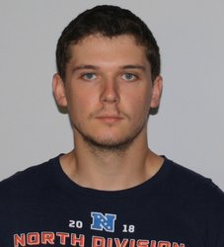
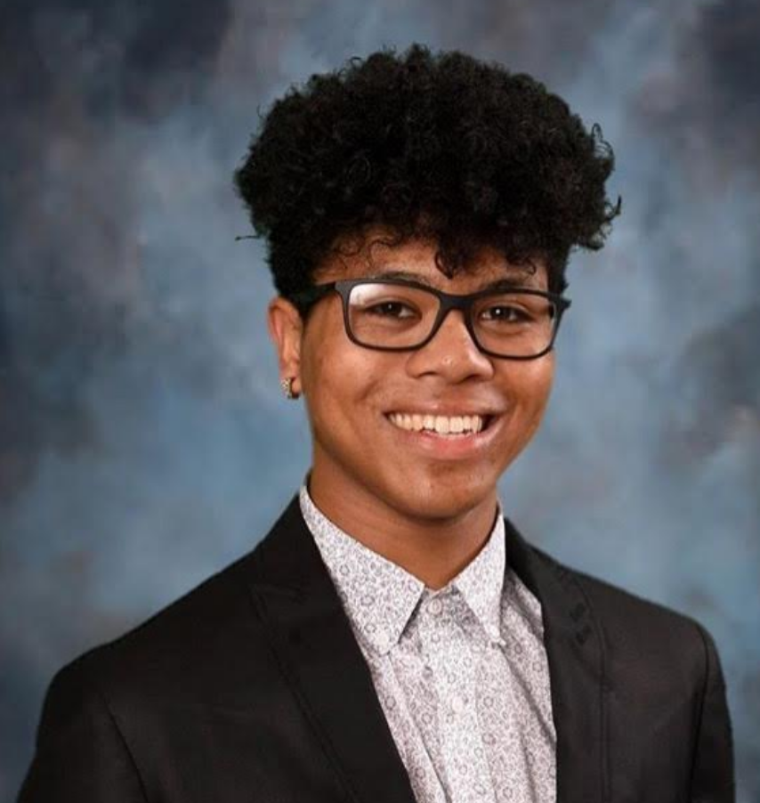
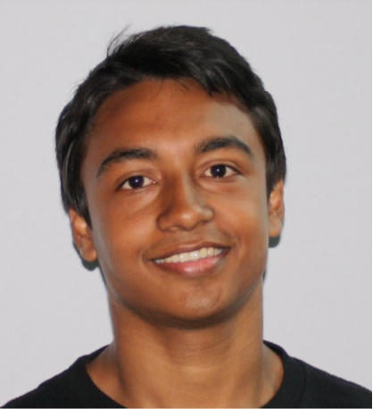
The Team
Mechanical Team - Flex Hinges & Nanogratings
Matt Dubiel - MMAE ‘20 Seth Graham - MMAE ‘21 Pranoy Roy - PSYCH, MMAE ‘20

Slide 6
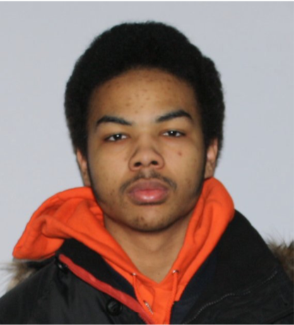
The Team
X-Ray Calibration
Public Outreach
Brack Turner - CS ‘21 Andy Fung - CS ‘21 Pranoy Roy - PSYCH, MMAE ‘20

Slide 7
Optical Simulation

Slide 8
Background
We are using 2D optics simulation code from previous team
Code estimates what an interference pattern may look like
Simulate propagation of waves through one-dimensional gratings
Code uses the Huygens-Fresnel principle to perform the calculations to generate a diffraction pattern
Notes:
Kaplan: Talk louder
Mancini: It’s a 2D calculation for a 1D grating. Ensure that the dimensions are understandable for the reviewers.

Slide 9
Huygens-Fresnel Principle
Reasons for using Huygens-Fresnel principle:
Employs a brute force calculation that is viable due to available computing power
Can handle arbitrary geometries
Allows for non-trivial variations in diffraction like effect of gravity or defects within the grating
Notes:
Reason to not use fourier transform
-“Non-trivial variations in diffractions”
-less complex to replicate in the code
Kaplan: Wants to know why Huygens-Fresnel > Fourier Transform
Mancini: Huygens-Fresnel is a 3-Space “brute force” calculation, the level of computing power is so large that brute force methods are viable, so we can use it. Other methods were done, like Gaussian & Fourier based approximations. Huygen’s-Fresnal can handle arbitrary geometries.

Slide 10
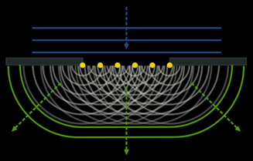
Huygens-Fresnel Principle
Notes:
An example of an incoming plane wave decomposed into outgoing spherical waves for a finite number of points on a single slit.

Slide 11
Initial Goals
Decrease runtime of simulation
Parallelize more parts of algorithm
Identify sub-algorithms that take the longest time
Attempt to correct those algorithms
Allow gratings to be procedurally generated/pseudo-random
Make simulation 3-dimensional

Slide 12
Analyzing Runtime
Diagnosing performance is required to optimize an algorithm
CPU usage
VRAM usage
Memory usage
We found that runtime scales O(N²) as a function of point sources used
We also found that VRAM usage scales linearly as a function of point sources used

Slide 13
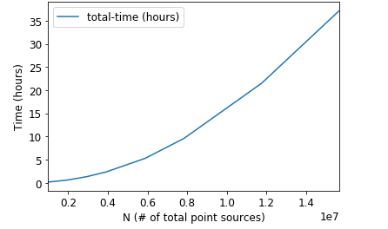
Analyzing Runtime
N (# of total point sources) | total-time (hours)
980000 | 0.142171
1960000 | 0.585482
2940000 | 1.320947
3920000 | 2.345460
5880000 | 5.268576
7840000 | 9.575953
11760000 | 21.491627
15680000 | 37.175367
Notes:
Mention that total time is composed of kernel time and mem-to-gpu time
-mem-to-gpu time is 195 miliseconds which is neglibile when in comparison to the 37 hour total runtime

Slide 14
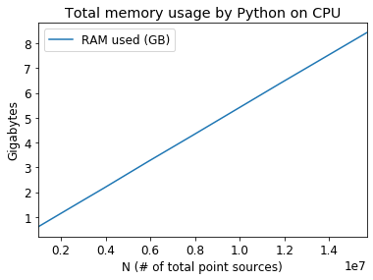
Analyzing Runtime
N (# of total point sources) | RAM used (GB)
980000 | 0.599099
1960000 | 1.121924
2940000 | 1.643728
3920000 | 2.162176
5880000 | 3.223385
7840000 | 4.260962
11760000 | 6.360155
15680000 | 8.429974

Slide 15
Parameter Optimization
Ran the simulation with varying source point parameters
When trends in results stop changing is indicative of the most accurate results
Ideal testing parameter
Increase in source points would not yield more accurate or different results
Intensity graph stops changing at about 300 source points per slit length

Slide 16
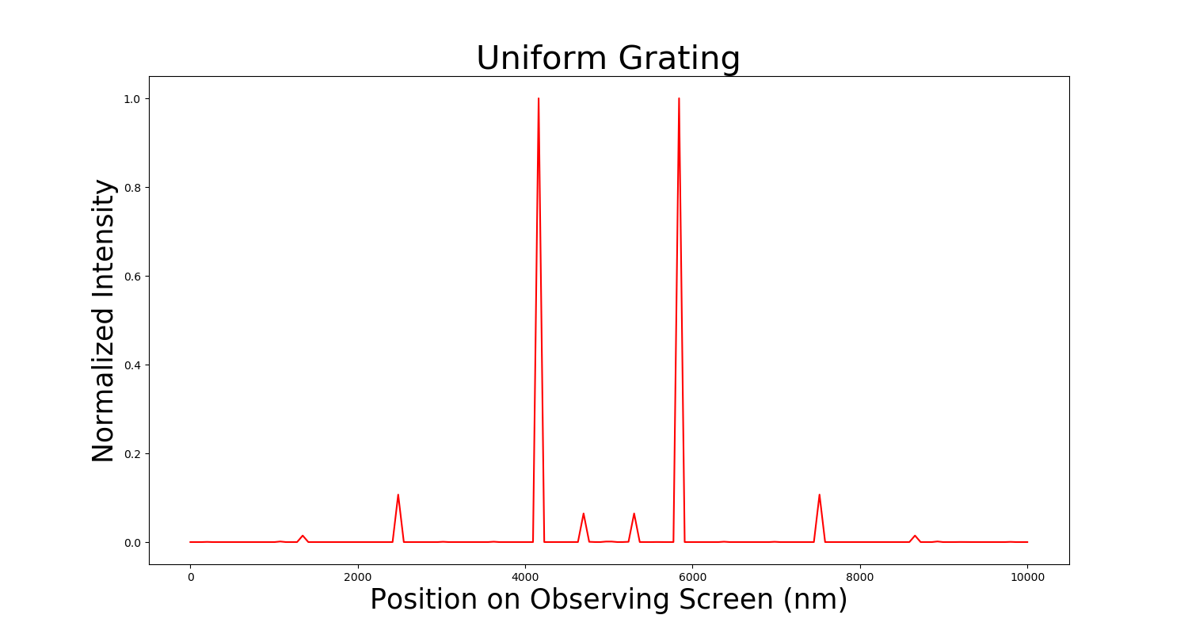
Parameter Optimization
300 point sources
(lux)
Notes:
300 point sources. Adding more point sources does not visibly change the interference pattern on the observing screen.
FROM FINAL PRES: Why is this a baseline?

Slide 17
Identifying Realistic Parameters
The right parameters are crucial in understanding what kind of runtime the simulation has
Source points per slit | 300
Slit length | 150um
Slit width | 50nm
Total Slits | 100,000
Notes:
source points per slit = 300
observation points = 150
slit height = 150um
slit width = 50nm
*Clarify slit height = slit length
Kaplan: Take our needless words

Slide 18
Input Data Generation
Issue in how data is passed
Huge amount of data needs to be passed into the CUDA kernel function and stored on the GPU
Possible solution by generating data on GPU as it is being requested
Notes:
Kaplan: These must be re-written as headlines, don’t write sentences.

Slide 19
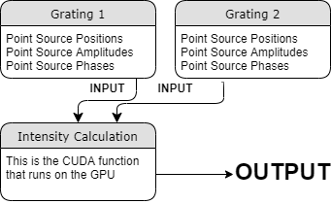
Input Data Generation
CPU
CPU
Objects that the gratings generate to pass to the CUDA function
Positions
Amplitudes
Phases
GPU
Notes:
*Specify that the “grating objects generate”
Kaplan: Rewrite

Slide 20
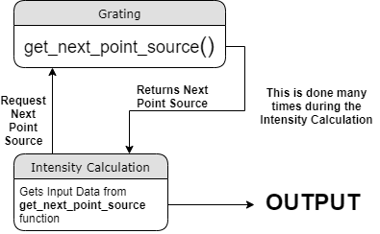
Input Data Generation
GPU
This shows the proposed solution where it will generate while the CUDA function is running.
GPU
Notes:
Kaplan: How does it handle an imperfect grating?
--It can but the code cannot do that yet.--

Slide 21
Generating data on the GPU vs CPU
Pros of generating data on the GPU
GPU memory can be used entirely for output, instead of input
Opportunity to rewrite the flawed grating library
Cons
Possible runtime increase
It would be difficult to generate arbitrary grating structures and still take advantage of parallel processing to decrease runtime
Notes:
Flawed:
poor variable name usage
hard to extend
Unnecessary duplicated code structure
Overuse of Object Oriented Programming

Slide 22
Achievements
Measured and analyzed the simulation runtime and identified multiple bottlenecks
Runtime increases O(N²) as a function of total number of point sources
Memory usage in the GPU scales linearly as a function of total number of point sources
Notes:
Mancini: Define what “instrumented” means, as the definition has a specific meaning in instrumentation science.
OR have an asterisk near it and have a footnote that defines that it is with respect to computer science terminology.

Slide 23
Achievements
Identified the lower limit for the number of point sources per slit (300) that still produce realistic diffraction patterns
Documented setup, installation, and prior code
Notes:
Mancini: “Upper-limit” should be “Lower-limit”.
Kaplan: Put this content on the report.

Slide 24
Challenges
Some code left by last semester was poorly documented making parts hard to understand
Did not have a full understanding of the physics in the simulation to completely validate the code
Some terms are used interchangeably for no reason and it makes it confusing
i.e. slit length vs slit height

Slide 25
Future Work
Allow gratings to be generated in a pseudo-random pattern
Include outside variables
Effect of gravity
Incorporation of defective slits
Notes:
*Change title to “Goals for next semester”

Slide 26
Future Work
Consideration in how to optimize the CUDA kernel
Methods in storing the output
Storing the output solely within the GPU to free up space.
Partitioning the results properly before the next calculation
Notes:
Derived from our results that we should store output within the GPU
-mention drawbacks
Optimally, partitioning the results before next calculation

Slide 27
Flexure Hinges

Slide 28
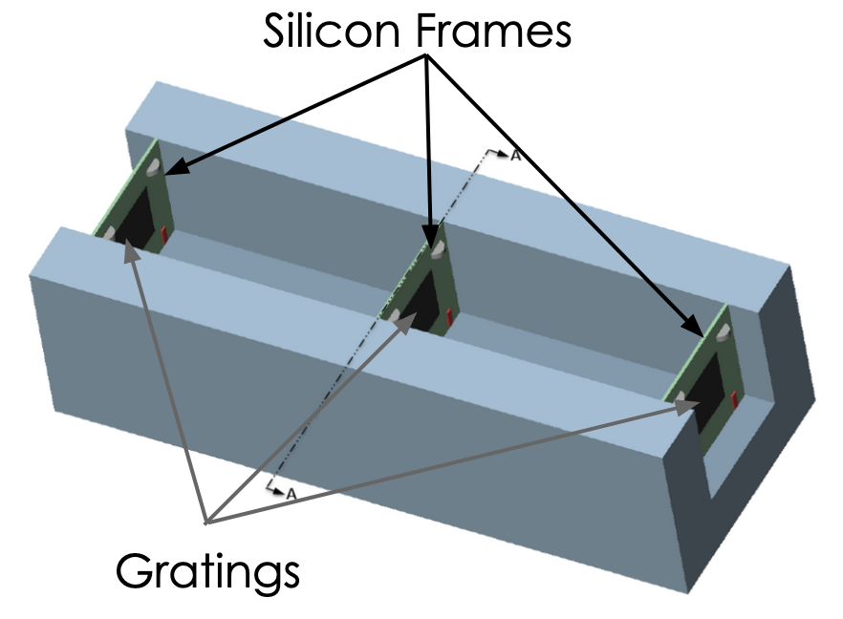
Purpose
Gratings will be mounted within Silicon frames in the interferometer
Frames need to be able to move gratings for alignment
2 Rotational
1 Translation
Flexure hinges incorporated into frames allow for precise controlled movement
Notes:
*incorporated

Slide 29
Objective
Previous group developed translational design with 3-notch hinges
Adapt 3-notch design to work in a rotational design
Achieve 0.5 degrees of rotation with a maximum of 5 N applied force from piezos
Notes:
good

Slide 30
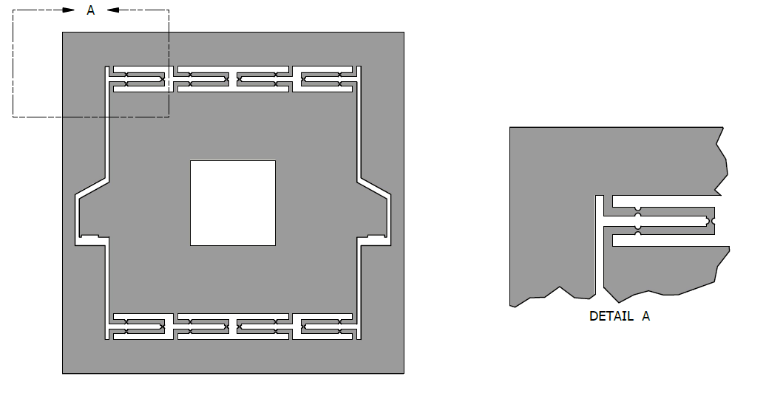
Translational Design
(Previous Semester)
Silicon
Notes:
Kaplan: It might help to say that gray is transitional

Slide 31
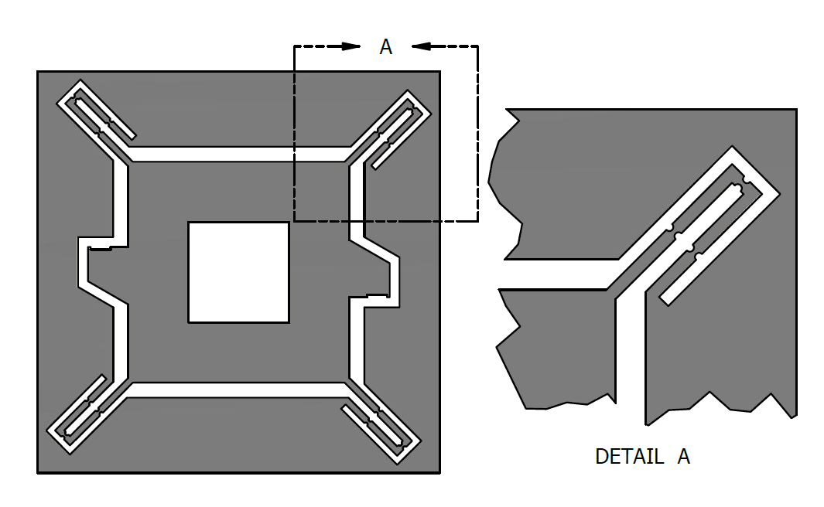
Rotational Design
Silicon
Notes:
FROM FINAL PRES: How much will this sag? Number?

Slide 32
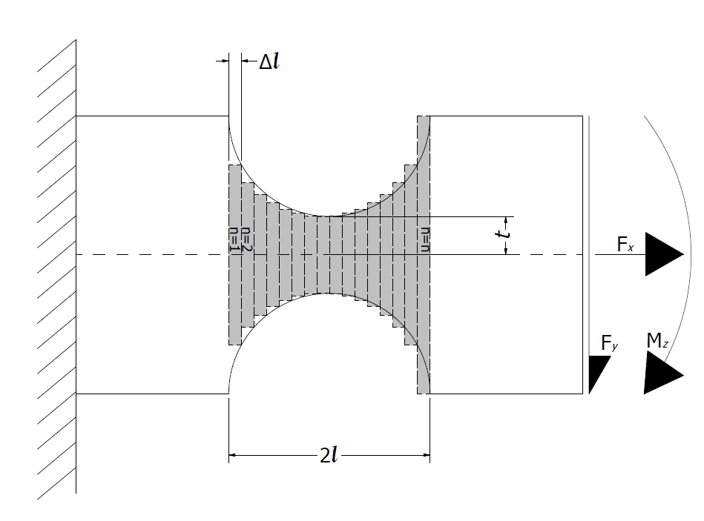
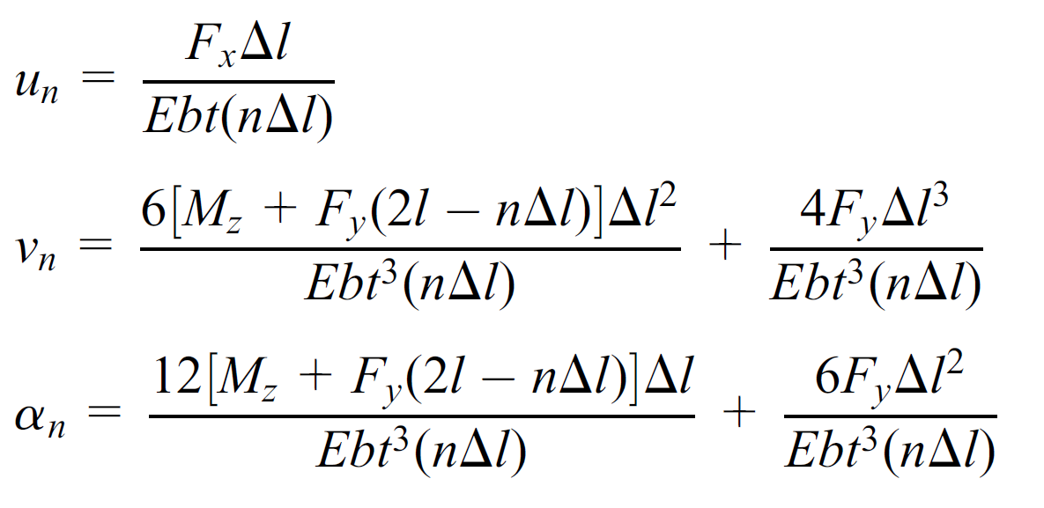
Analytical Model
Single notch hinges commonly modeled as cantilevers
Cannot model 3 notch design as cantilever
Use single notch model
Refine in FEA
Deflection
Equations
Notes:
Analytic and analytical mean different things, i think you mean analytical.
FROM FINAL PRES: Why look at analytical model?
Shaded area is not a notch, it is a ‘link’
How much does it bend?
Guest prof: You shouldn’t model each division as a cantilever

Slide 33
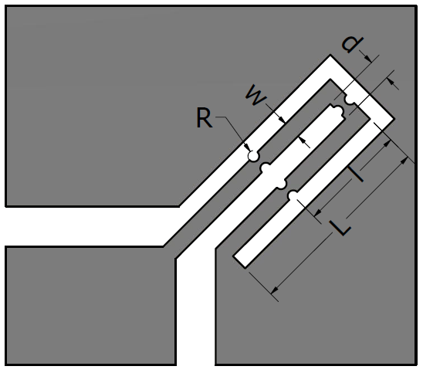
Parameterization
Examine 5 different parameters
Manipulate these parameters to achieve desired amount of rotation
Silicon crystal orientation is held constant
Notes:
Bigger font, maybe not black so it stands out more in the diagram.
FROM FINAL PRES:
Q about thickness

Slide 34
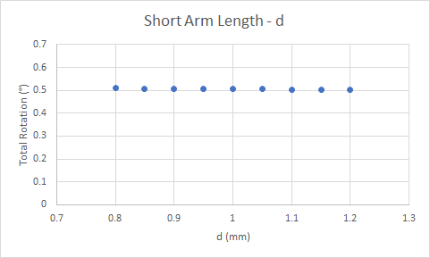
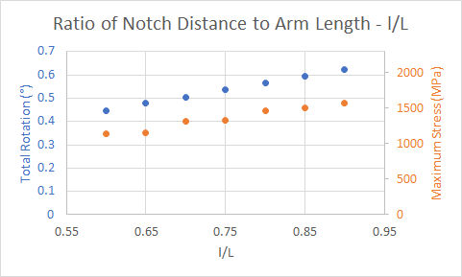
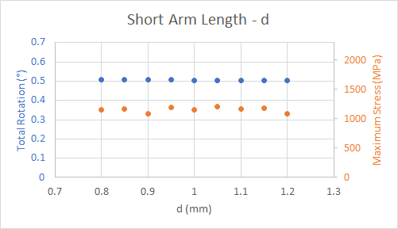
ANSYS FEA Results
Notes:
Change title FEA results
Is L a ratio or what? Dont call it a distance. Dont change your diagram, instead simply do the splot and do the notch ratio L over ?
FROM FINAL PRES:
Rotation under what conditions (5n of force)?

Slide 35
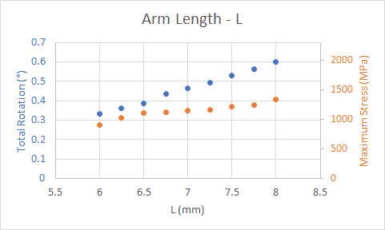
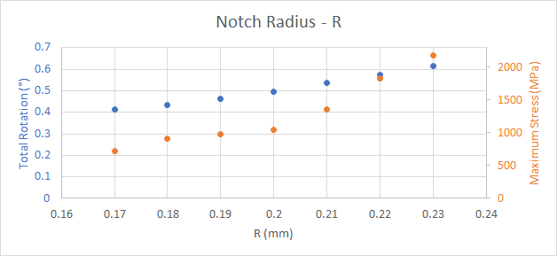
ANSYS FEA Results
Notes:
FROM FINAL PRES:
These are very optimistic numbers, manufacturing will make everything suck more

Slide 36
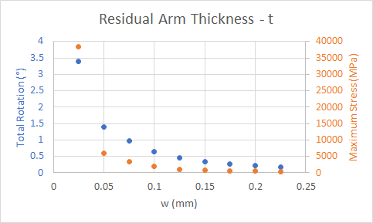
ANSYS FEA Results
Relations are linear except for residual arm thickness
Residual arm thickness follows non-linear relation similar to model
Notes:
Plot the residual not the arm thickness, misleading plot?
FROM FINAL PRES:
Should w be t?
What is yield strength for silicon crystals? What’s a reasonable yield stress for the manufactured product?

Slide 37
Conclusion
Final Values
Hinges achieve 0.51° of rotation with 1151 MPa maximum stress at 5 N applied force
Single crystal silicon yield strength as high as 7000 MPa but can be drastically reduced during manufacturing
Arm thickness, notch radius, and arm length have largest effect on rotation
Short Arm length has very little effect
Parameter Name | Parameter Variable | Final Value
Notch Radius | R | 0.21 mm
Arm Length | L | 7.25 mm
Ratio of Notch Distance to Total Length | l/L | 70 %
Short Arm Length | d | 0.80 mm
Width | w | 0.65 mm
Notes:
It could be really nice if you showed the stress in another slide and compare it with the yield strength of the material
Possible addition: when looking at a figure of merit, ex rotation at 5newtons, it measures how useful a design is. Imagine doing a parametric plot. 4d or 3d plot that shows it. 1 param vs another and show that as a 3d plot.

Slide 38
Future Work
Current system is idealized
Measure the effects of unequal applied forces from piezo actuators
Analyze out of plane deflection, potential for piezos to be misaligned
Vary crystal orientation
Notes:
Make sure to put the crystal orientation in the presentation and the final report.

Slide 39
Nanogratings

Slide 40
Initial Goals
Run random vibrational analysis with ANSYS
Relate results to the design of nanogratings

Slide 41
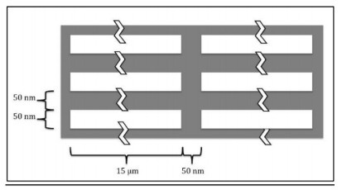
Cantilever Beam
0.375 µm
Modeled cantilever beam of Silicon Nitride with a fixed end and a free end.
Used dimensions of a grating strut from CAD file
Thickness is two times grating height (2*50nm).
50 nm
Notes:
What did u model it with? What tool? ANSYS. Put it on the first slide and in the report.
.375 is too small for what we’re trying to build, what are the drawbacks of it? Not as much of the muonium beam is measured
You mentioned a minimum thickness? What does it mean? The minimum we can build it.

Slide 42
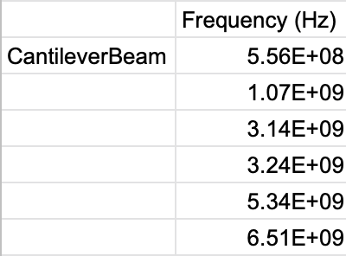
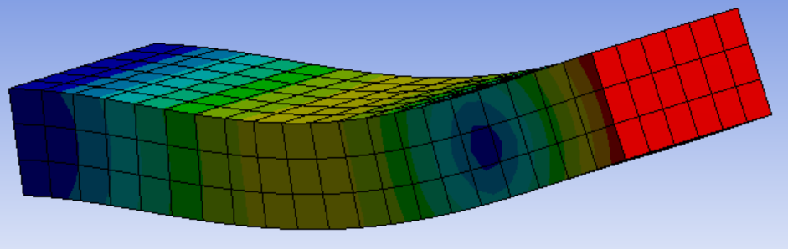
Cantilever Beam
Natural frequencies of beam:
Notes:
Put the material on the slide.
Put on the slide that it is the total def

Slide 43
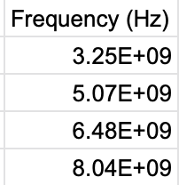
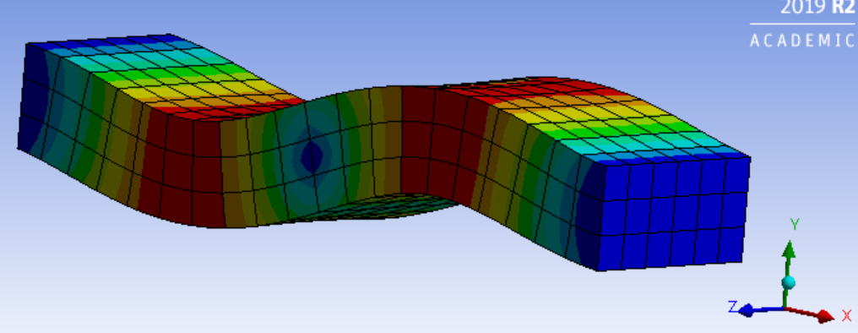
Cantilever Beam
Two fixed ends:

Slide 44
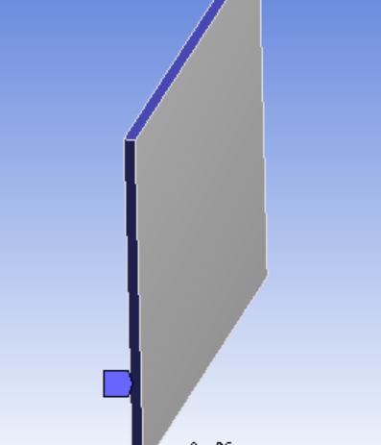
Vibration Modes
Modeled grating structure
with no slits. (Fixed
frame as Boundary
Condition).
Natural frequencies agree
with Cantilever beam.

Slide 45
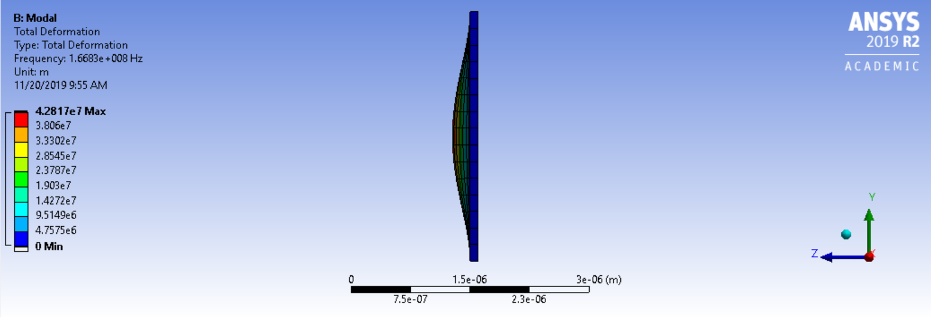
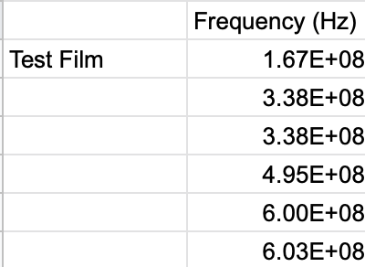
Test Film
Notes:
Given the boundary conditions, the oscillations are occuring in the Z-direction.
Make a cantilever beam on the other dimension

Slide 46
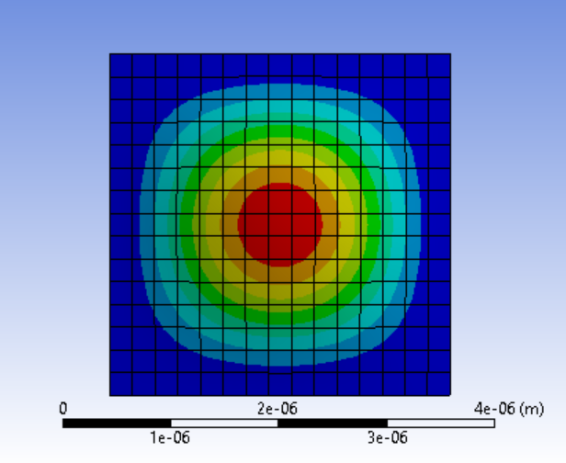
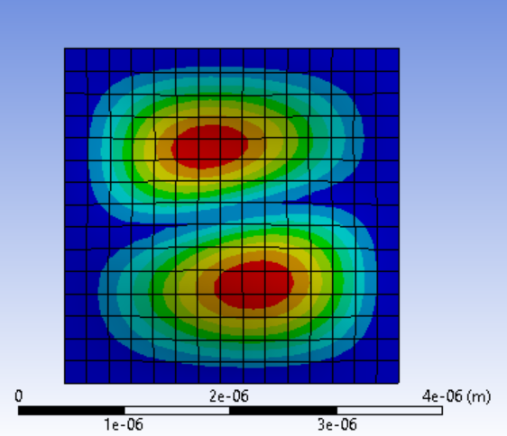
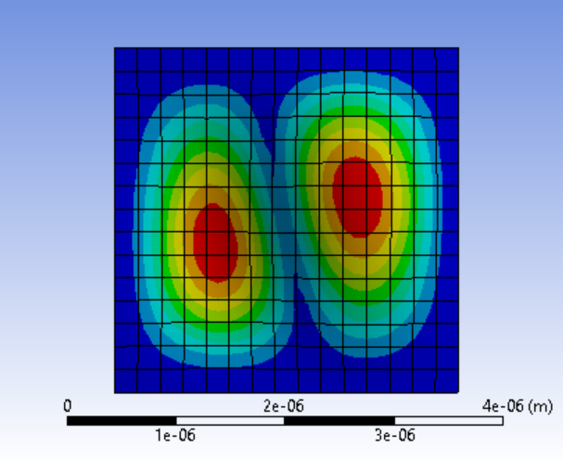
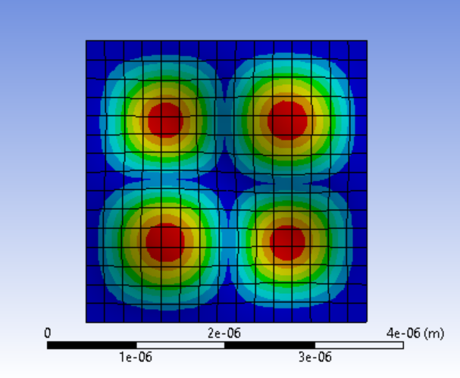
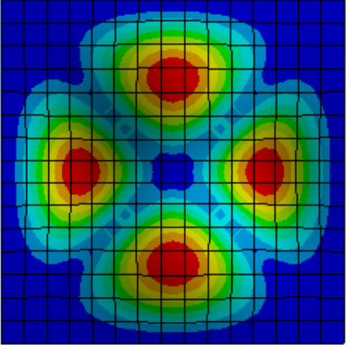
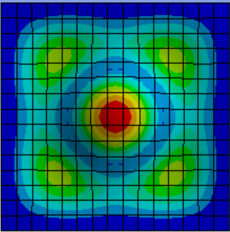
Vibration Modes

Slide 47
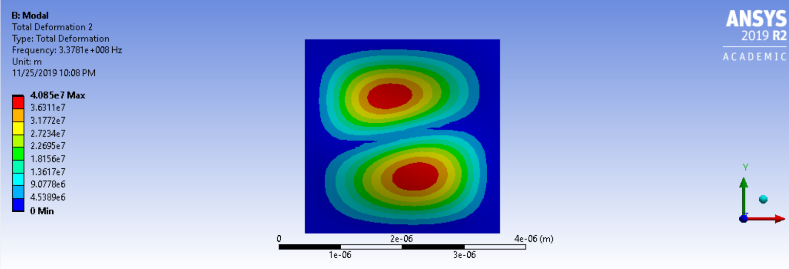
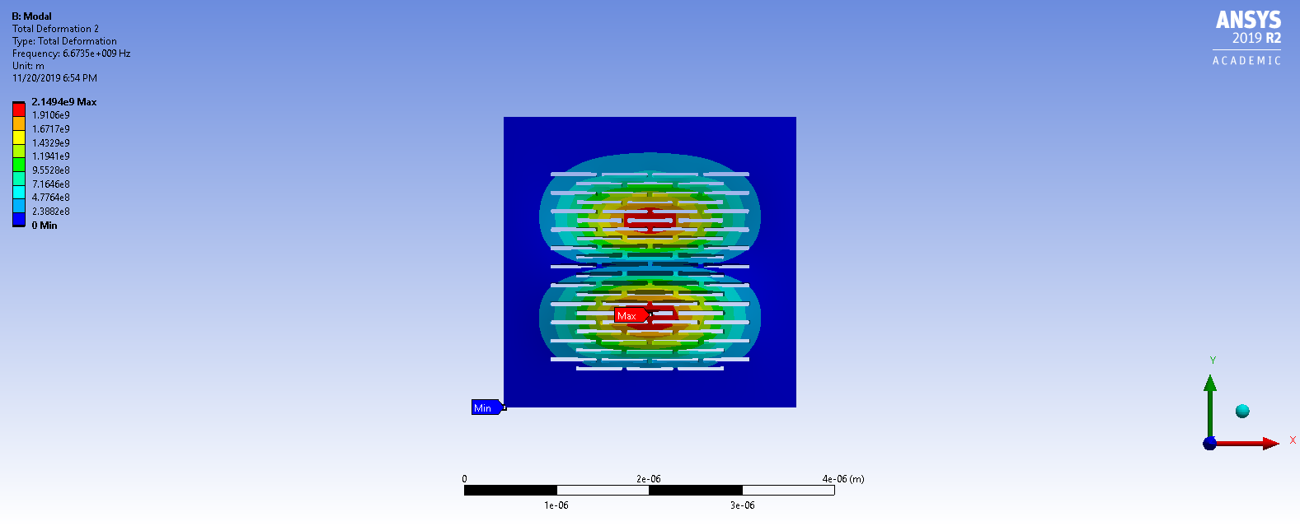
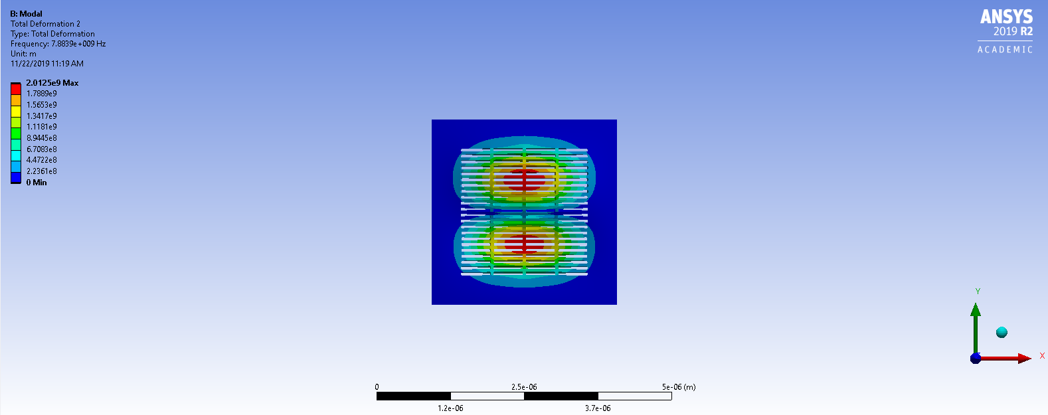
Mode 2 Comparison
Test Film (Student)
Ashlar (Full)
Columnar (Full)
Notes:
Reference the ANSYS Student Community
FROM FINAL PRES: No units, `(m)` is incorrect

Slide 48
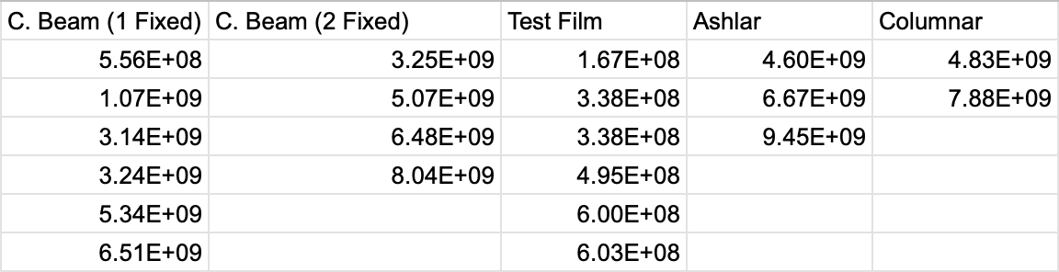
Natural Frequencies (Hz)
Notes:
ANSYS was only able to display limited modes for smaller element sizes. Elapsed time for solution was greater than CPU time (RAM?)
We can see that with the grating designs, the natural frequencies are higher than the test film.
Something about 10^-7, i didnt understand it fully.

Slide 49
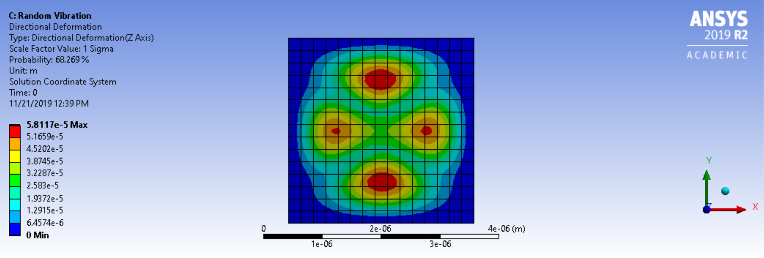
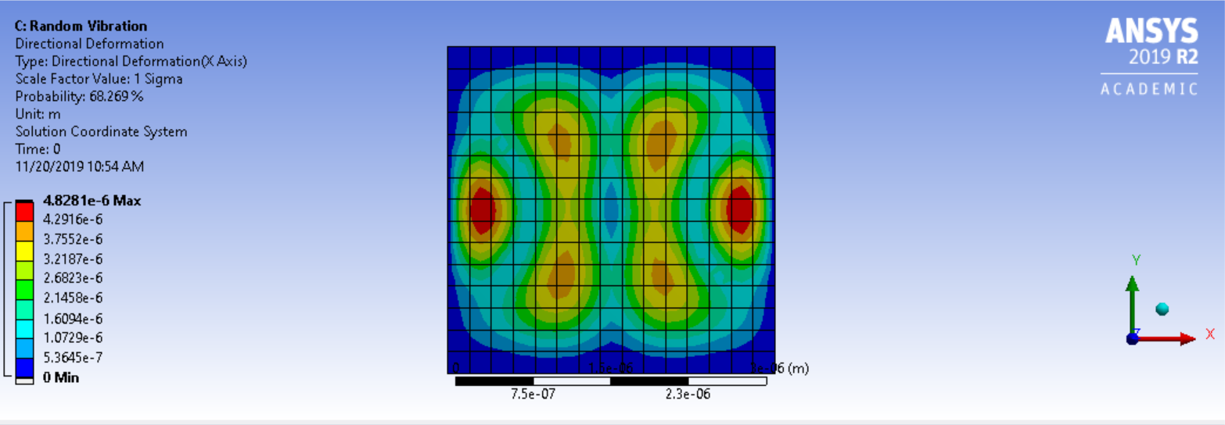
Directional Deformation
Z-Direction (m)
X-Direction (m)
Notes:
This is the directional deformation of the test film due to random vibrations.
Make words bigger on the images.
What are the dimensions of your film? 3.15E^6 ?? <- he said it doesnt make sense. A frequency in hertz make no sense.
FROM FINAL PRES: No units, `(m)` is incorrect

Slide 50
Accomplishments
Determined the range of natural frequencies for nanograting structures.
Done through simulating cantilever beam and film.
Provided documentation for future semesters on how to proceed.
Notes:
The dimensions are the same for all the gratings. You said you wanted to change something to natural frequency. Get rid of the ear drum thing ?? where is the documentation? Add it to the final report

Slide 51
Challenges
ANSYS only displayed <6 frequency modes when solving Modal Analysis.
Elapsed Time > CPU time, need more RAM or better hard drive configuration for all modes to show.

Slide 52
Future Work
Secure more RAM/Change hard drive config.
Allows Random Vibration analysis on all structures.
Relate drum vibration analytical model to results.
Notes:
They are not supposed to be sentences. How long did it take? You need to know

Slide 53
X-Ray Calibration

Slide 54
Goals
Find a suitable code that can effectively simulate a grating rather than a few slits
Generate a uniform grating that can produce accurate results
Run an analysis on the diffraction pattern formed

Slide 55
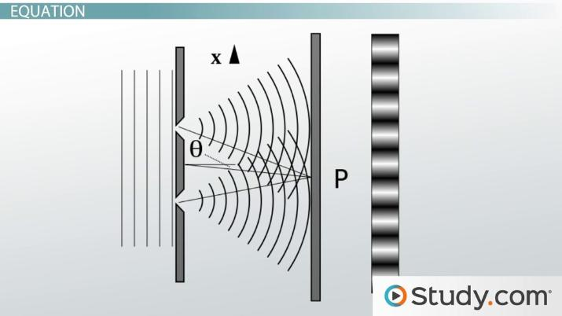
Background
X-ray Calibration code from UCL(University College London)
Simulates x-ray propagation through a two dimensional uniform grating
Used to correct misalignment in gratings
Simulate properties of a muonium beam
Notes:
Why do we want Xray calibration? Make a separate slide describing what the goal of the team is in general.

Slide 56
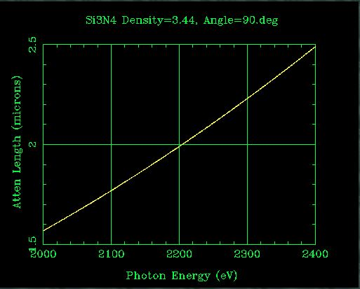
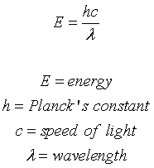
Attenuation Length
Parameters are crucial in simulating the right x-ray energy and determining x-ray absorption length
2.215 keV is needed to achieve an attenuation length of the proposed 2 microns
Using Planck's equation, a wavelength of 0.56nm is determined to be suited for our case

Slide 57

Moire Pattern
Helps correct misalignment in multiple gratings
Taking an x-ray image of multiple gratings to observe defects
One grating image means it is aligned

Slide 58
Analysis of Diffraction Pattern
Investigated Wavepy, a Python library for data analyses of coherence and wavefront measurements at synchrotron beamlines
Covers Single-grating Talbot Interferometry analysis
Requires TIFF image file to run

Slide 59
Simulation of X-ray Propagation
UCL diffraction code uses Matlab plotting to represent waveforms in the Fourier domain.
Previous group maxed 10 slits at 100 pixels high
Increased amount of slits to 51 at 20 pixels high, however grating is not uniform yet

Slide 60


Intensity Distribution of 51 slits
Intensity Distribution at real space distance of 17m
Notes:
Explain what the left hand graph is? Why is it a 3d graph it is not clear. Something cut off at the top of the first graph.
If you are modeling a bunch of slits in this direction, then the output should a have a one dimensional dispersion. It doesnt mke sense since you are modelling an array of holes.idk its hard to follow what they’re saying. They said a lot about these results here. Double check the values on the plot.

Slide 61
Future Work
Need to account for three dimensional space regarding thickness of the grading
Make more uniform grating by collaborating with nanogratings group
Look into pyXSFW for a full x-ray simulation code & analysis simultaneously

Slide 62
Public Outreach

Slide 63
Purpose
Raise awareness for work invested in this IPRO
Raise funding as result of increased publicity

Slide 64
Plan/Future Work
Strategies to raise more awareness
Reaching out to engineering groups for an event
Create website and brochures summarizing IPRO and impact
Follow up with strategies and influencing people
Present to Chicago Society for Space Studies and Adler

Slide 65
Accomplishments
Created a website summarizing this IPRO’s work and achievements using Wix
https://proy51.wixsite.com/antimattermuonium
Created brochures to hand out during events using Adobe Spark
Notes:
During ipro day - brochure
The website is published but still being worked on

Slide 66
Future Work
Update the website of the work done in the future semester
Plan an event with ASME about this IPRO
Plan an event with Chicago Society for Space and Adler

Slide 67
Questions?

Slide 68
Appendix

Slide 69

Cantilever Beam

Slide 70

Vibration Modes

Slide 71
Backup Slides

Slide 72


Slide 73

Parameter Optimization
25 point sources
Notes:
25 point sources

Slide 74

Parameter Optimization
100 point sources
Notes:
100 point sources

Slide 75
Parameter Optimization
1600 point sources
(lux)
Notes:
300 point sources. Adding more point sources does not visibly change the interference pattern on the observing screen.
Kaplan: Be ready to explain why this is the expected graph
*Show a figure of the shape you are talking about; ensure length and height are defined correctly.
*Be sure to mention that this is a 2D
*Define that this is 1600 point sources along the vertical dimension.

Slide 76
Parameter Optimization

